Slide 1




DEBUG KINGS
HACKTOBERFEST 1.0

Slide 2






Problem statement

Slide 3


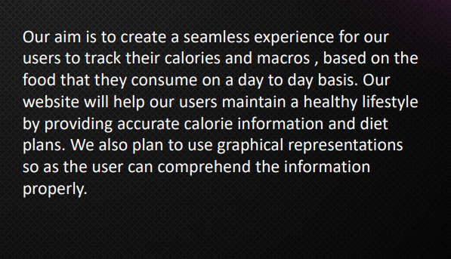

Solution

Slide 4


Key Features and Functionality
Easy to use attractive UI
Robust searching and multiple search options
Customizable settings to tailor user experience and easy navigation

Slide 5



Social impact

Slide 6


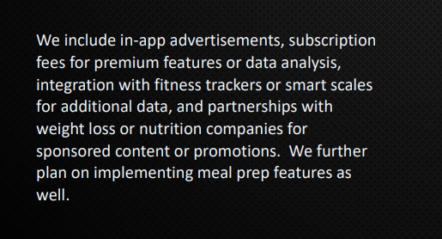
Revenue Model

Slide 7


Technologies Used
OUR TEAM UTILIZED A VARIETY OF TECHNOLOGIES INCLUDING PROGRAMMING LANGUAGES LIKE JAVA AND PYTHON, AS WELL AS TOOLS LIKE GITHUB AND AWS. WE ARE ALSO USING HTML AND SQL

Slide 8




The Team
ASHWIN NAIR
ABEL ABRAHAM
RUBEN NEBU
Lead developer
Front End Developer
Documentation

Slide 9


Thank You
HACKTOBER FEST

